Slide 1
Dobbs Elementary
GO Team Meeting
November 30, 2023

Slide 2


Where We Are
Our strategic plan is the guide for the work we’re doing in the school. By monitoring the plan and ranking priorities, we can all work towards the common goals. Using the priorities in the strategic plan, the school leadership team developed a Continuous Improvement Plan (CIP) for the current school year.

Slide 3
Discussion Items
Current Strategic Plan
Continuous Improvement Plan
Needs Assessment
SMART GOALS
Monitoring Measures
MAP Data
Data Protocol

Slide 4
Current
Strategic Plan
2021-2025

Slide 5
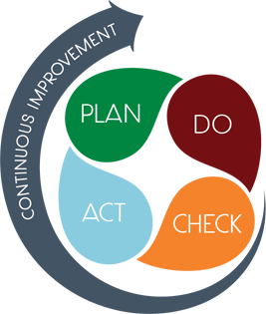
STRATEGIC PLAN SMART GOALS
Priorities
  Increase literacy proficiency
  Increase math/numeracy proficiency
  Increase the Average Daily Attendance
  Increase STEM integration across all content areas
SMART GOALS
  The percentage of students in grades 3-5 scoring proficient or above in reading/ELA will increase from 12% to 17% and decrease the percentage of students scoring beginning from 58% to 53% on the 2024 GMAS.
  The percentage of students in grades 3-5 scoring proficient or above in Math will increase from 10% to 15% and decrease the percentage of students scoring beginning from 61% to 56% on the 2024 GMAS.
  The Average Daily Attendance rate will increase to 94% during the 2023-2024 school year.

Slide 6
Dobbs Elementary
Mission
To foster a 21st century learning environment that integrates the community and school through a culture of mutual respect, high academic standards , and technology innovation.
Vision
To provide rigorous, innovative, and engaging learning experiences through diverse partnerships designed to cultivate fiscally responsible citizens who are college and career ready..
SMART Goals
The percentage of students in grades 3-5 scoring proficient or above in reading/ELA will increase from 12% to 17% and decrease the percentage of students scoring beginning from 58% to 53% on the 2024 GMAS.
The percentage of students in grades 3-5 scoring proficient or above in Math will increase from 10% to 15% and decrease the percentage of students scoring beginning from 61% to 56% on the 2024 GMAS.
The Average Daily Attendance rate will increase to 94% during the 2023-2024 school year.
APS Strategic Priorities & Initiatives
School Strategic Priorities
School Strategies
1. Increase proficiency in literacy and mathematics
2. Increase daily average attendance rate
3. Increase staff capacity in literacy instruction
4. Increase staff capacity in data analysis and usage for instructional decision-making
5. Increase STEM integration
1A. Monitor the delivery of Tier 1 Instruction to include Rollins
1B. Monitor the Data Analysis Assessments weekly & monthly
1B. Monitor the delivery of Small Group Instruction
1B. Utilize small group instruction to provide individualized instruction
Fostering Academic Excellence for All Data
Curriculum & Instruction Signature Program
2A. : Utilize the Whole Child Intervention Team to track students’ absences
2B. Monitor the reduction of chronically absent students as evidenced by the CARE TEAM
2B. Implement attendance incentive program
Building a Culture of Student Support
Whole Child & Intervention Personalized Learning
3. Monitor the Collaborative Planning Process to include analyzing standards and data
Equipping & Empowering Leaders & Staff
Strategic Staff Support Equitable Resource Allocation
4A: Staff engagement in weekly data meetings
4B: Implement Weekly and Unit Common Assessments to address gaps in Standards
5. Implement & utilize the STEM learning profiles across the content areas
Creating a System of School Support
Strategic Staff Support
Equitable Resource Allocation
14

Slide 7
Our Current
Progress Monitoring Measures
Literacy
Numeracy
Whole Child
Weekly Assessments
Unit Assessments
Common Formative Assessments
Fall MAP Assessment
Winter MAP Assessment
Spring MAP Assessment
Weekly Assessments
Unit Assessments
Common Formative Assessments
Fall MAP Assessment
Winter MAP Assessment
Spring MAP Assessment
SEL – Morning Announcements
BASC Assessment – Fall & Spring
Attendance – Weekly
(Care Team/Student Attendance Committee)
Counselor & SW Supports
  HAZEL – Virtual FREE clinic
  SW Assistance (Parents/scholars)
  Counseling Groups

Slide 8
MAPS Data
1st Administration

Slide 9
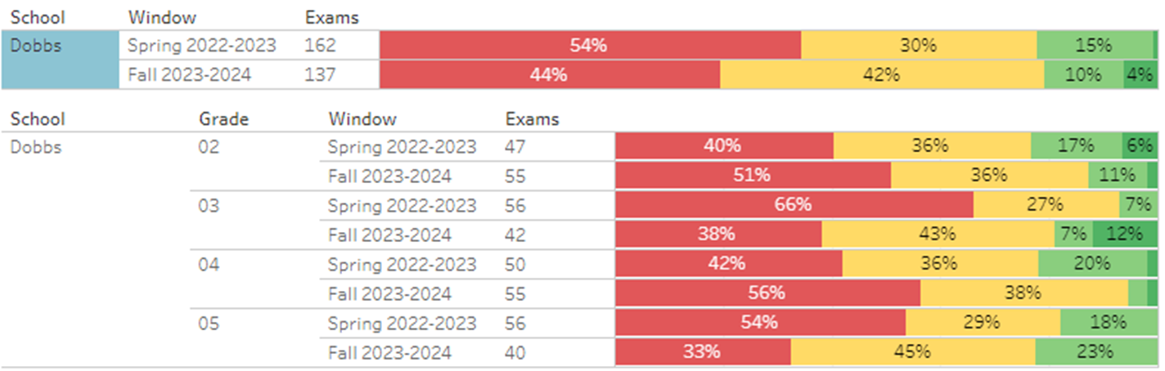
MAP Growth Reading Data
Spring 2023 to Fall 2023

Slide 10
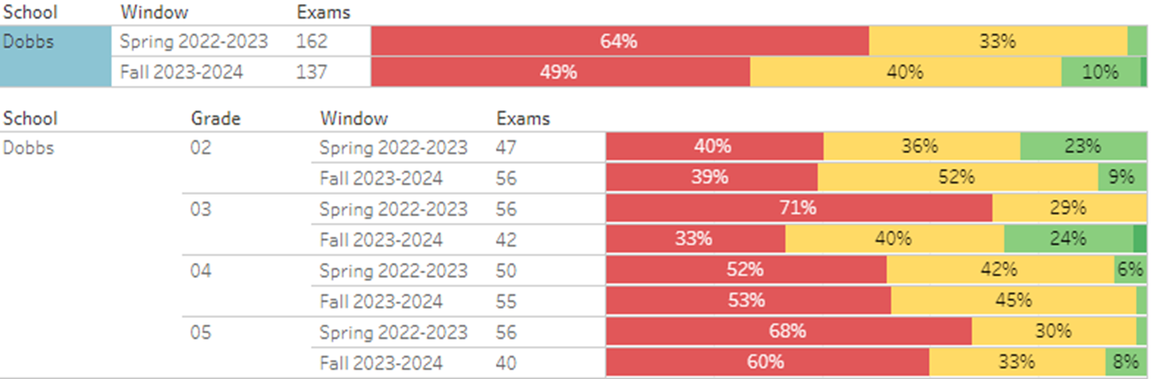
MAP Growth MATH Data
Spring 2023 to Fall 2023

Slide 11
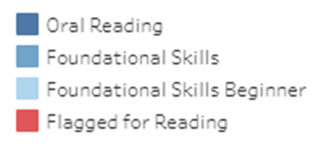
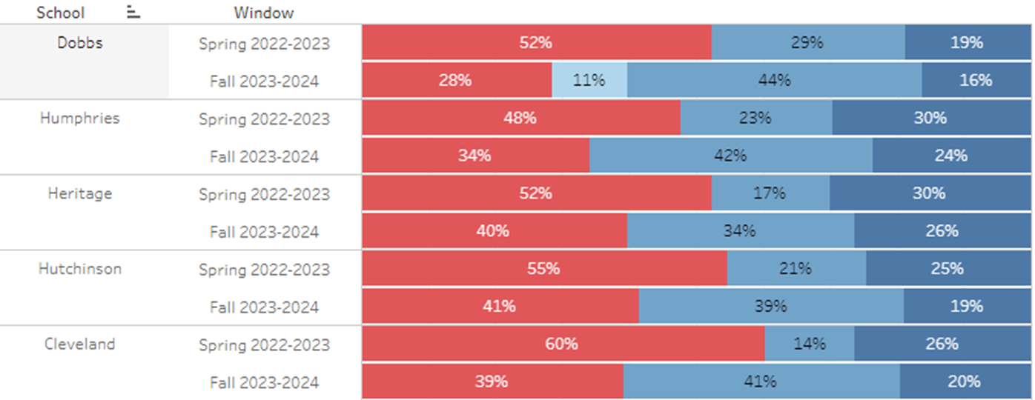
MAP Growth FLUENCY Data
Spring 2023 to Fall 2023

Slide 12
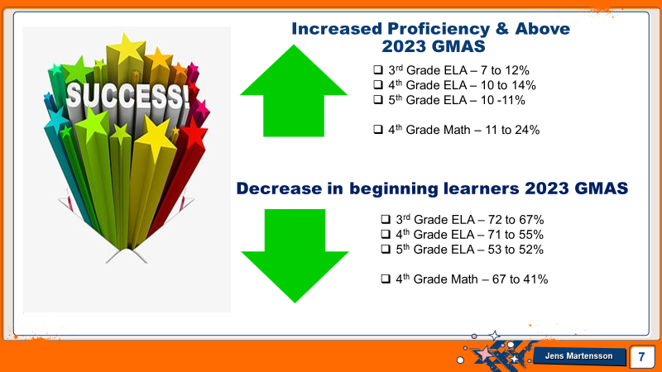

Slide 13
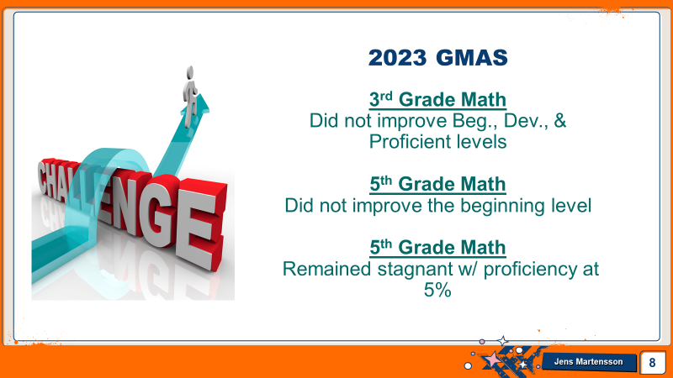

Slide 14

GO Team Discussion:
Data Protocol
What do you notice?
What are your wonderings?
What additional questions do you have?

Slide 15
ROLLINS’ Implementation
Cox Campus modules for teachers and staff
ORAL LANGUAGE - Accountable Talk Schoolwide
Early Literacy Implementation
Coach went to training in Columbus, GA
Upcoming - Shadowing a Rollins School in Marietta

Slide 16
Enrollment & Leveling
As of August 1, 2023
251 Students
As of November 30, 2023 315 Students
Due to enrollment being under projection (318), we lost $32,134.
Leveling - Instead of losing a teacher, i requested that the vacant non-instructional para position be removed.

Slide 17


Where we’re going
At our next meeting(s) we will discuss how our data is aligning to our strategic plan and determine if we need to make any adjustments.
Before the end of Fall Semester, we will take Action (vote) on ranking our strategic priorities.

Slide 18
October/November Events
Fall Festival/Trunk or Treat
Literacy Pumpkin Contest
Character Parade
Jump 4 Books Give Away
Red Ribbon Week
Thanksgiving Luncheon w/ Parents
Cluster Parent Meeting
Superintendent’s Community Mtg.
Town Hall Meeting
  Academic Celebration
  Attendance Celebration
  Behavior Celebration
  SEL
Inclusive Schools Week
Behavior Incentive Field Trip

Slide 19
Thank you

